Slide 1
Chapter No. 03 – A Top-Level View of Computer Function and Interconnection
Week – 05
5-9 March 2018
(Part-02)

Slide 2
Topics to Cover
Interrupts
I/O Function
3.3 Interconnection Structures
3.4 Bus Interconnection
Bus Structure
Multiple Buses
Elements of Bus Design
Quiz-2 (Ch-3) Next Class

Slide 3
What is an ‘Interrupt’?
An interrupt is a signal to the processor from a device attached to a computer or from a program within the computer indicating an event that needs immediate attention.
Interrupts provide a mechanism by which other modules (I/O, memory) may interrupt the normal processing of the processor.
An interrupt alerts the processor to a high-priority condition requiring the interruption of the current code the processor is executing.
The processor responds by suspending its current activities, saving its state, and executing a function called an ISR to deal with the event.
This interruption is temporary, and, after the interrupt handler finishes, the processor resumes normal activities.

Slide 4
Types of Interrupts
There are two types of interrupts:
Hardware interrupts 2) Software interrupts.
Hardware interrupts: are used by devices to communicate that they require attention from the operating system.
‘Hardware interrupts’ are generated when a key is pressed or when the mouse is moved.
Software interrupt: is caused from executing a program/instruction within the computer that requires the operating system to stop and figure out what to do next. (e.g. int 21h in assembly)
‘Software interrupts’ are generated by a program requiring disk input or output.

Slide 5
Classes of Interrupts
Interrupts can be of any of the four types:
Program interrupt: Generated by some condition that occurs as a result of an instruction execution e.g. overflow, division by zero.
Timer interrupt: Generated by a timer within a processor. This allows the operating system to perform certain functions on a regular basis. Used in pre-emptive multi-tasking (time for a task).
I/O interrupt: Generated by an I/O controller, to signal normal completion of an operation, or to request service from the CPU.
Hardware Failure: Generated by a failure such as power failure or memory parity error (bit), or to signal a variety of error conditions.

Slide 6
Importance of Interrupts
The purpose of interrupts is to improve processing efficiency.
For example, most external devices are much slower than the CPU.
Suppose that the processor is transferring data to a printer using the ‘instruction cycle’ scheme.
After each ‘write’ operation, the processor must pause and remain idle until the printer catches up.
The length of this pause may be on the order of many hundreds or even thousands of instruction cycles that do not involve memory.
Clearly, this is a very wasteful use of the processor.
During the wait cycles, the CPU can work on other task until interrupt.

Slide 7
Fig. 3.7 Program Flow Control (Next Slide)
The user program performs a series of WRITE calls to an I/O device interleaved with processing. Code segments 1, 2 and 3 refer to sequence of instructions that do not involve I/O.
The WRITE calls are to an I/O program (driver) that is a system utility and that will perform the actual I/O operation (to manage & control computer resources).
Because the I/O operation may take a relatively long time to complete, the user program is hung up waiting for the operation to complete; hence the user program is stopped at the point of the WRITE call for some considerable period of time.

Slide 8
Stages of an I/O Write Operation (Figure Next)
The I/O program consists of three sections:
Section-1: A sequence of instructions, labelled 4 in the figure, to prepare for the actual I/O operation. This may include copying the data to be output into a special buffer and preparing the parameters for a device command.
Section-2: The actual I/O command. Without the use of interrupts (Fig.a), once this command is issued, the program must wait for the I/O device to perform the requested function (or periodically poll the device). The program may wait to determine if the operation is done.
Section-3: A sequence of instructions, labelled 5 in the figure, to complete the operation. This may include setting a flag indicating the success or failure of the operation.

Slide 9
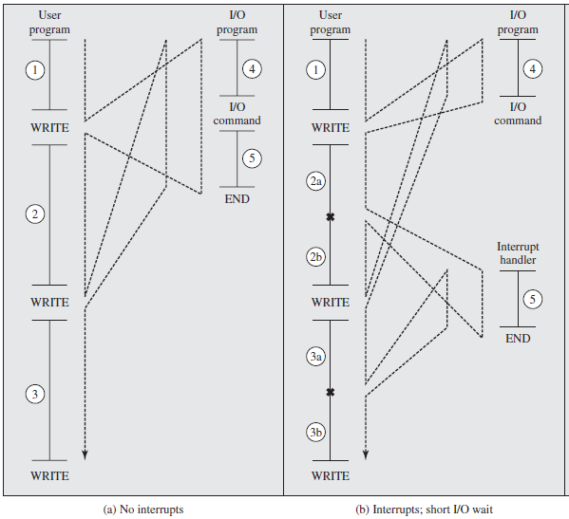
Program Flow Control without and with Interrupts
Wait
state
X = interrupt occurs
during course of execution
of user program.

Slide 10
Interrupt Cycle added to Instruction Cycle
With interrupts, the processor can be engaged in executing other instructions while an I/O operation is in progress.
As before, the user program reaches a point at which it makes a system call in the form of a WRITE call.
The I/O program that is invoked in this case consists only of the preparation code and the actual I/O command.
After these few instructions have been executed, control returns to the user program.
Meanwhile, the external device is busy accepting data from computer memory and printing it.
The I/O operation is carried along with the execution of user program.

Slide 11
Interrupt Handler (See Fig. Last Slide)
When the external device becomes ready to be serviced – that is, when it is ready to accept more data from the processor – the I/O module for the external device sends an interrupt request signal to the processor. The processor responds by suspending operation of the current program, branching off to a program to service that particular I/O device, known as interrupt handler. (an OS program)
The processor resumes the original program execution after the device is serviced.
The points at which such interrupts occur are shown with X in figure.

Slide 12
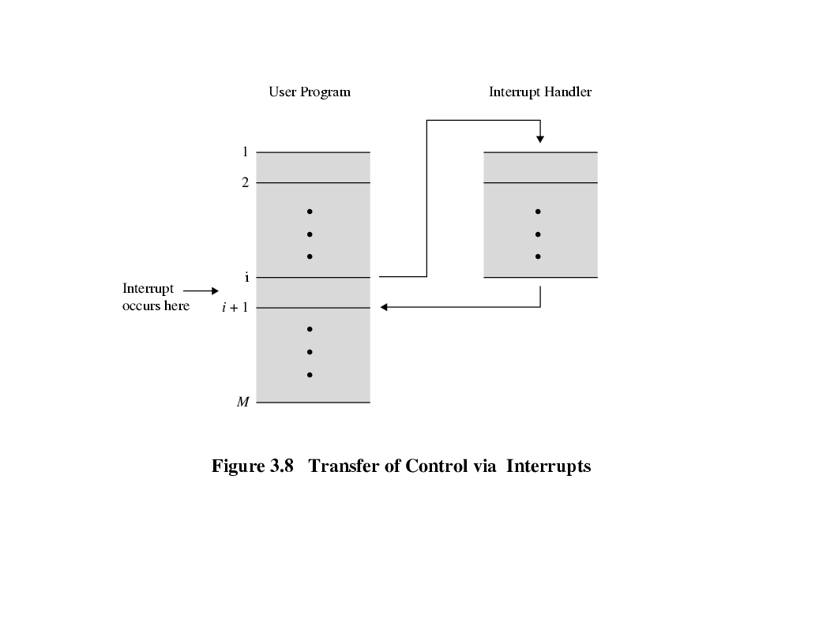
Fig. 3.8 Transfer of Control via Interrupts
From the point of view of the user program, an interrupt is just that: an interruption of the normal sequence of execution.
When the interrupt processing is completed, execution resumes (Fig. 3.8).
Thus, the user program does not have to contain any special code to accommodate interrupts;
The processor and the operating system are responsible for suspending the user program and then resuming it at the same point.
I
n
t
e
r
r
u
p
t
Solved

Slide 13
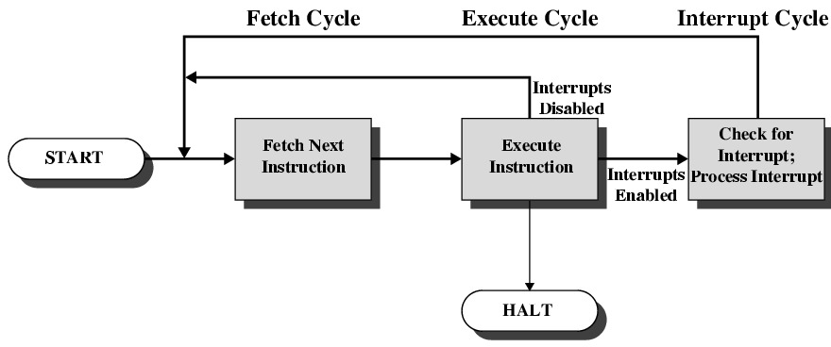
Instruction Cycle with ‘Interrupts Cycle’
To accommodate interrupts, an interrupt cycle is added to the ‘instruction cycle’. (See Fig. 3.9 below)
In the interrupt cycle the processor checks to see if any interrupts have occurred, indicated by the presence of an interrupt signal.
If no interrupts are pending, the processor proceeds to the fetch cycle and fetches the next instruction of the current program.

Slide 14
Steps of ‘Interrupt Handler Process’
If an interrupt is pending, the processor does the following:
It suspends execution of the current program being executed and saves its context to the stack. It also saves the current contents of the PC (program counter) that contains the address of the next instruction to be executed.
It sets the program counter to the starting address of the interrupt handler routine. (it determines nature of interrupt and does action).
The processor now proceeds to the fetch cycle and fetches the first instruction in the ‘interrupt handler program’, which will service the interrupt. (this program is part of the operating system).
When the interrupt handler routine is completed, the processor can resume execution of the user program at the point of interruption.

Slide 15
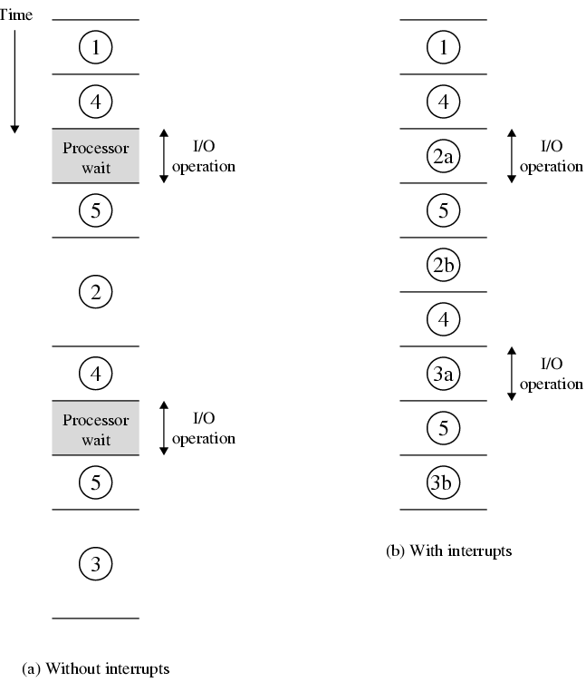
‘Program Timing’, Short I/O Wait
Write
Write
Code 2 is
interrupted
Code 2a
executes
while I/O is performed.
Timing diagram based on the flow of control.
In Fig. (a), without interrupts, during I/O operations, the processor waits while an I/O operation is performed.
In Fig. (b), with interrupts, the I/O operation is carried in concurrent with processor executing.
This saves valuable processing time.
Result: Gain in ‘system performance’.
Write
Upon the
Completion
Of I/O
Operation
Interrupt
Occurs,
Program
Resumes
From 2b.
Write

Slide 16
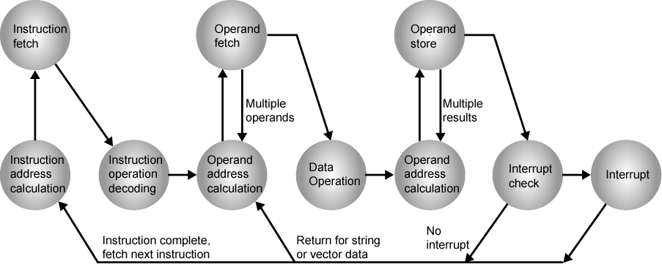
Instruction Cycle, ‘State Diagram’ with Interrupts

Slide 17
Multiple Interrupts
There is a possibility that multiple interrupts can occur at a time.
For example, a program may be receiving data from communication line and printing results.
The printer will generate interrupt every time it completes a printer operation.
The communication line controller will generate an interrupt every time a unit of data arrives. (e.g. a character or a block of data)
In any case, it is possible for a communications interrupt to occur while a printer interrupt is being processed.

Slide 18
Two Approaches to Dealing with ‘Multiple Interrupts’
Disable interrupts (Maskable interrupt)
Processor will ignore further interrupts whilst processing one interrupt.
Interrupts remain pending and are checked after first interrupt (ISR) has been processed.
Interrupts handled in sequence as they occur. (e.g. data may be lost on a line)
Drawback, it does not take into account relative priority, or time critical needs.
Define priorities (Non-Maskable interrupt)
Low priority interrupts can be interrupted by higher priority interrupts.
When higher priority interrupt has been processed, processor returns to previous interrupt.

Slide 19
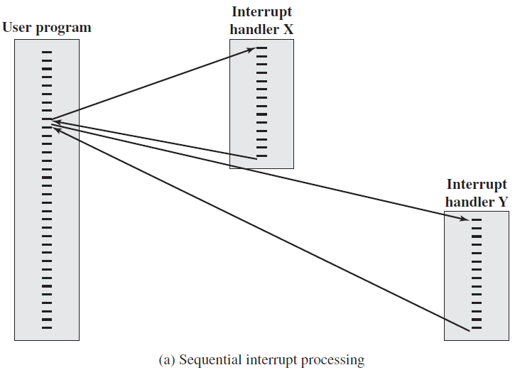
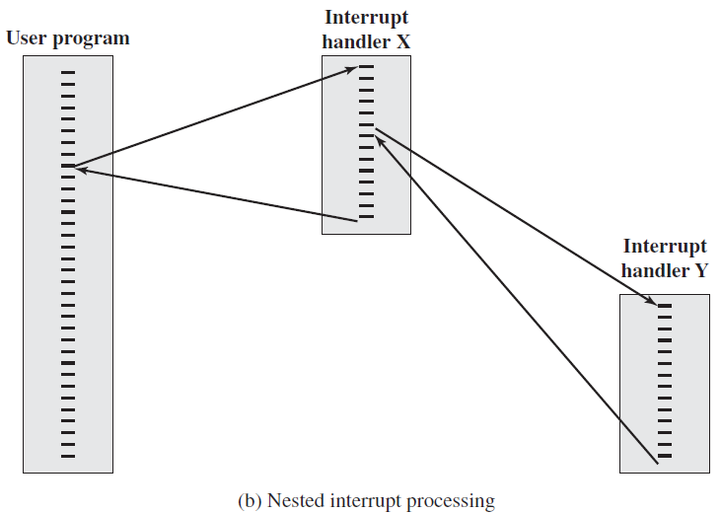
Fig. 3.13 Transfer of Control with Multiple Interrupts
Disable Interrupt Scheme
Interrupt Priority Scheme

Slide 20
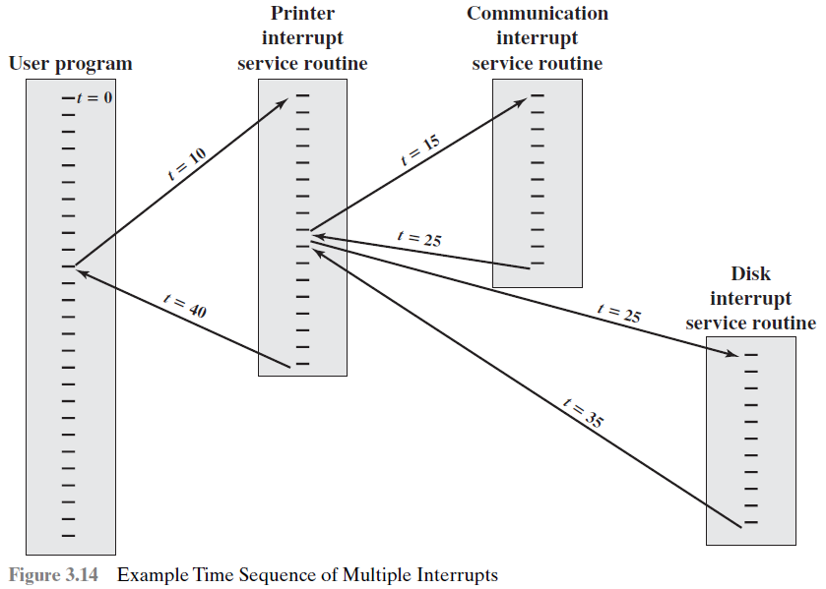
Fig. 3.14 Example Time Sequence of Multiple Interrupts
This is an example of interrupt priority scheme.
Consider a system with three I/O devices: a printer, a disk and a communication line.
With increasing priorities of 2,4 & 5.
Program begins t=0.
Disk interrupt has
a lower priority, so
it is simply held, and
Communication ISR
runs to completion.
Priority=5
Priority=2
Priority=4
Now the user
program can
resume execution
by picking its contents
from the stack.
(Half)

Slide 21
3.3 Interconnection Structure
A computer consists of a set of components or modules of three types:
Processor
Memory
Input/output (I/O)
These modules need to communicate with each other, so there must be paths for connecting the modules.
The collection of paths connecting the various modules (CPU, memory & I/O) is called the interconnection structure.
For each module type has its own forms of input and output.

Slide 22
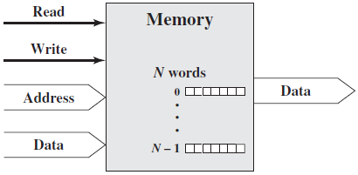
Memory Module and its Data Exchange
A memory module consists of N words of equal length.
Each word is assigned a unique numerical address from (0, 1, …, N-1).
A word of data can be read from or written into the memory.
The nature of operation is indicated by read and write control signals.
The location for the operation is specified by an address.
Note: The wide arrows
represent multiple signal
lines, carrying multiple bits
of information in parallel.

Slide 23
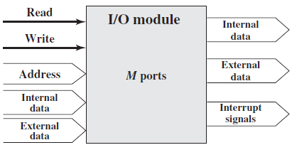
I/O Module and its Data Exchange
From the computer’s point of view, I/O is exactly similar to memory.
There are two operations read and write.
An I/O module may control more than one external device.
We refer to each of the interfaces to an external device as a port and give each a unique address (e.g., 0, 1, …, M-1).
An I/O module may be able to send interrupt signals to the processor.
Input
Receive data from peripheral
Receive data from computer
Output
Send data to computer
Send data to peripheral
Internal Data: Data inside system.
External Data: Data outside system.

Slide 24
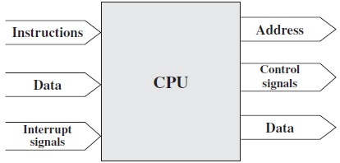
Processor Module and its Data Exchange
The processor reads in instructions and data, writes out data after processing.
It uses control signals to control the overall operation of the system.
It also receives interrupt signals and acts on them.

Slide 25
Types of Data Transfer b/w Computer Modules
The interconnection structure must support the following types of transfer:
Memory to processor: The processor reads an instruction or a unit of data from memory.
Processor to memory: The processor writes a unit of data to memory.
I/O to processor: The processor reads data from an I/O device via an I/O module.
Processor to I/O: The processor sends data to the I/O device.
I/O to or from memory: Direct memory access (DMA) via I/O.

Slide 26

3.4 Bus Interconnection
A bus is a shared transmission medium.
A Bus is a communication pathway connecting two or more devices.
A bus consists of multiple communication pathways, or lines, often grouped. A System Bus connects major computer components.
A number of line/channel in one bus, each capable of carrying one bit.
Over time, a sequence of binary digits can be transmitted over a single line.
Taken together, several lines of a bus can be used to transmit binary data simultaneously (in parallel).
e.g. 32 bit data bus is 32 separate single bit channels.
For example, an 8-bit unit of data can be transmitted over eight bus lines.
Clock
Cycles

Slide 27
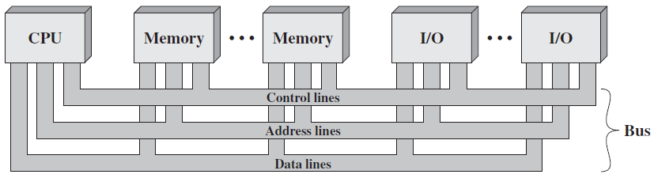
Types of Buses
A system bus consists typically, of from about fifty to hundreds of separate lines.
Each line is assigned a particular meaning or function.
The bus lines can be classified into three groups:
1) Address lines (bus) 2) Data lines (bus) 3) Control lines (bus)
In addition, there may be power distribution lines to attached module.
Two way
Communication;
Read & Write

Slide 28
1. Data Bus
The data lines provide a path for moving data among system modules.
These lines, collectively, are called the data bus.
The data bus may consist of 32, 64, 128 or even more separate lines.
Each line can carry only one bit at a time, the number of lines determine how many bits can be transferred at a time.
The number of these data lines are called the width of the data bus.
The width of the data bus determines the overall system performance.
For example, if the data bus is 32 bits wide and each instruction is 64 bits long, then the processor must access the memory module twice during each instruction cycle. (e.g. two fetch operations in each line)

Slide 29
2. Address Bus
Skip
The address lines are used to designate the source or destination of the data on the data bus.
If the processor wishes to read a word (8, 16 or 32 bits) of data from memory, it puts the address of the desired word on the address lines.
The width of the address bus determines the maximum ‘memory capacity’ of the system. (i.e. more bits mean more memory locations)
E.g. 8080 has 16 bit address bus giving 2^16 = 64k address space.
Furthermore, the address lines are also used to address I/O ports.
The higher-order bits are used to select a particular module on the bus, and the lower-order bits select a memory location or I/O port.

Slide 30
3. Control Bus
Skip
The control lines are used to control the access to and the use of the data and address lines.
Because data and address lines are shared by all components, there must be a means of controlling their use.
Control signals transmit both command and timing information among system modules. (Control Unit)
Timing signals indicate the validity of data and address information.
Command signals specify operations to be performed.
Typical control line signals are given in the next slide.

Slide 31
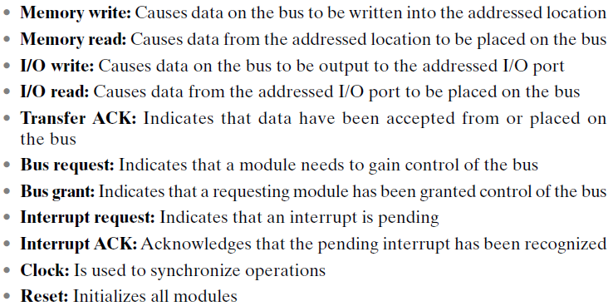
Control Line Signals
Skip

Slide 32
Limitations of Bus Design
A bus is a shared transmission medium.
Multiple devices connect to the bus, and a signal transmitted by any one device is available for reception by all other devices attached to the bus.
If two devices transmit during the same time period, their signals will overlap and will become garbled (Make false by subtract or addition).
Thus, only one device at a time can successfully transmit.
We need to set up rules so that only one device can take control of the bus at a time.

Slide 33
Bus Operation Explained
If one module wishes to send data to another, it must do two things:
Obtain the use of the bus, using ‘bus request’ control signal.
Transfer data via the bus, using memory write or I/O write signal.
If one module wishes to request data from another module, it must:
Obtain the use of the bus, using ‘bus request’ control signal.
Transfer a request to the other module over the appropriate control and address lines, using memory read or I/O read control signal.
It must then wait for the second module to send the data.

Slide 34
Single-Bus Problems
If a great number of devices are connected to a single bus, performance will suffer. There are two main causes:
In general, the more devices attached to the bus, the greater the bus length and hence the greater the propagation delay.
Delay in co-ordination of bus use can adversely affect performance.
The bus may become a bottleneck as the aggregate data transfer demand approaches the capacity of the bus.
This problem can be countered to some extent by increasing the data rate that the bus can carry and by using wider buses.
Solution: Instead of a single –bus, use multiple buses in a hierarchy.

Slide 35
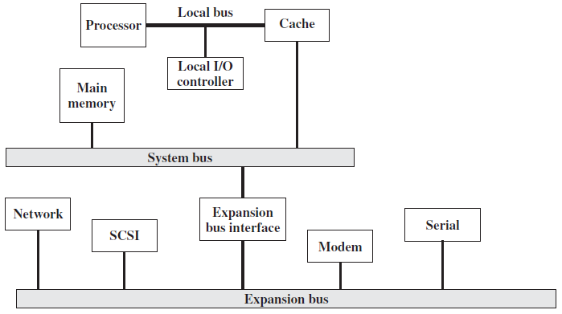
Traditional Bus Architecture
Break

Slide 36
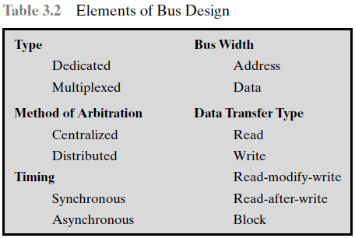
Elements of Bus Design

Slide 37
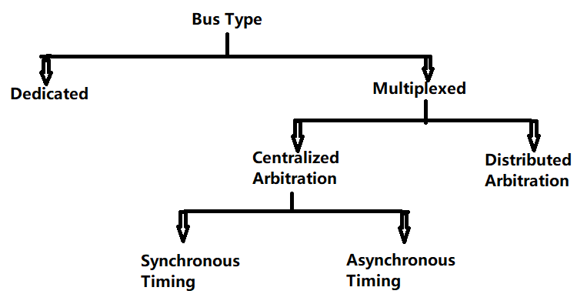
Hierarchy – Elements of Bus Design
Types of buses
Dedicated
Multiplexed
Distributed Arbitration
Centralized Arbitration
Synchronous Timing
Asynchronous Timing.

Slide 38
Bus Types
Bus lines can be separated into two generic types:
Dedicated 2) Multiplexed
Dedicated bus line: is permanently assigned to one physical subset of computer components. E.g. processor and cache.
It refers to the use of multiple buses, each of which connects only a subset of modules.
An example is the use of separate dedicated address and data lines.
The potential advantage of physical dedication is high throughput (data rate), because there is less bus contention.
A disadvantage is the increased size and cost of the system.

Slide 39
Multiplexed Bus
Multiplexed bus line: Using the same set of lines for multiple purposes and multiple modules is known as time multiplexing.
For example, address and data information may be transmitted over the same set of lines using an Address Valid control line.
First place address, each module copies address and determines if it’s the addressed module. The address is removed from the bus and the same bus is used for the subsequent read or write data transfer.
The advantage is the use of fewer lines, which saves space and cost.
Disadvantage, more complex circuitry is needed within each module.
There is a reduction in performance because certain events that share the same line cannot take place in parallel.

Slide 40
Method of Arbitration & Its Types
In multiplexed, more than one module may need control of the bus.
The purpose of arbitration is to designate one device as master/slave.
Because only one unit can successfully transmit over the bus, some method of arbitration is needed (to gain control of the bus).
The two arbitration methods can be classified as:
Centralized arbitration (e.g. CPU) 2) Distributed arbitration
Centralized arbitration: a single hardware device, called an arbiter or bus controller, is responsible for allocating time on the bus. CPU.
Distributed arbitration: there is no central controller. Rather, each module contains access control logic and the modules act together to share the bus. (e.g. they sense if line is available or not)

Slide 41
Bus Timing & Its Types
In centralized arbitration, each device is allocated time on the bus.
Timing refers to the way in which events are coordinated on the bus.
Buses use two types of timing:
Synchronous timing 2) Asynchronous timing
Synchronous timing: The occurrence of events on the bus is determined by a clock. It uses ‘Time multiplexing’ technique.
It is simpler to implement and test, however it is less flexible (fixed Cl)
Asynchronous timing: the occurrence of one event on a bus follows and depends on the occurrence of a previous event.
Advantage, a mixture of slow and fast devices, can share a bus.

Slide 42
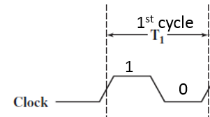
Timing of Synchronous Bus Operation
With Synchronous bus timing
Events determined by clock signals
Control Bus includes clock line
A single 1-0 is a bus/clock cycle, ‘time slot’.
All devices can read clock line
Usually sync on leading edge
Usually a single cycle for an event
In a simple example, the processor places a memory address on the address line during the first clock cycle, it may assert status symbols.
Once the address lines have stabilized, the processor issues an address enable signal.

Slide 43
See Synchronous Timing Figure (Next Slide)
For read operation, the processor issues a read command at the start of the second cycle.
A memory module recognizes the address and, after a delay of one cycle, places the data on the data lines.
The processor reads the data from the data lines and drops the read signal.
For a write operation, the processor puts the data on the data lines at the start of the second cycle and issues a write command.
The memory module copies the information from the data lines during the third clock cycle.

Slide 44
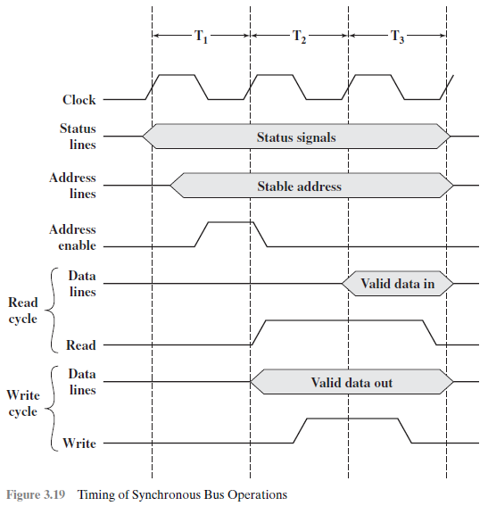
Synchronous Bus Timing
1st cycle
2nd cycle
3rd cycle
1
1
1
0
0
0
(Bus is Busy)
(Bus is Busy)
1st cycle place
Read Operation Sequence:
Place memory address on address line.
Issues ‘address enable’ signal.
Issues ‘read’ single in 2nd cycle.
Memory module recognizes address.
Places data on ‘data lines’, 3rd cycle.
1
Address
enable
Data placed
Read=1
Second cycle
‘Address’ is placed on Address bus.
Write Operation Sequence:
Processor puts ‘data’, 2nd cycle.
Then issues a ‘write’ command.
Memory module copies data
from ‘data lines’ in 3rd cycle.
Data placed
Data copied
Write=1
Write
Enabled

Slide 45
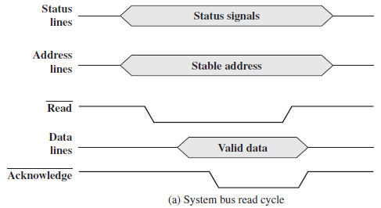
Asynchronous Read Operation
(Bus is Busy)
Steps of Asynchronous Read Operation:
The processor places
‘address’ and ‘status’ signals.
2. Then it issues a read command.
3. The memory decodes address
and places the data on the ‘data line’.
4. Memory gives ‘acknowledge’ signal.
5. Master reads data, removes read.
6. Memory drops data and Ack signal.
7. The master removes the address.
Step-1
Step-2: Read command
Step-3: Places data
Step-4: Ack signal

Slide 46
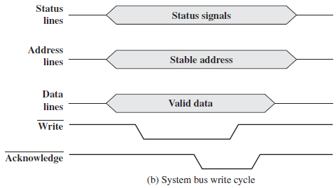
Asynchronous Write Operation
Step-1
Steps of Asynchronous Write Operation:
Master simultaneously places data,
status and address on respective lines.
2. Then it issues the ‘Write’ command.
3. Memory module copies the data.
4. Then it asserts the acknowledge line.
5. Master drops the write signal.
6. Memory drops the acknowledge signal.
Step-1
Step-1
Step-2: Copies data
Step-3

Slide 47
Read for Knowledge
Hardware interrupts are asynchronous and can occur in the middle of instruction execution, requiring additional care in programming. The act of initiating a hardware interrupt is referred to as an interrupt request (IRQ).
Each interrupt has its own interrupt handler. The number of hardware interrupts is limited by the number of interrupt request (IRQ) lines to the processor, but there may be hundreds of different software interrupts. Interrupts are a commonly used technique for computer multitasking, especially in real-time computing. Such a system is said to be interrupt-driven.

Slide 48
Preparatory Questions
What are the two ‘types of interrupts’? Explain.
What are the different ‘classes of interrupts’?
Write down the steps of ‘interrupt handler process’.
List and briefly define two approaches to dealing with ‘multiple interrupts’.
What is the ‘limitation’ of a bus design?
Explain the ‘bus operation’ for a read & write operation, using ‘bus request’ signal.
What is a ‘system bus’? Explain its three constituent buses.
List the different ‘elements of a bus design’. (Bus-type, method of arbitration, timing).

Slide 49
Quiz 02 – From Chapter 03 – Next Class
Homework: Read point-to-point interconnection structure. (Topic 3.5)
This topics is not included in Exam.
Quiz-2 (Ch-3) Next Class
Assignment-2 (Submission) Next Week

